Slide 1
Home Assistant AC control
Preda Mihai Alexandru

Slide 2
Project goal
Develop remote control functionality for air conditioning (AC) units from within the home
Seamlessly integrate AC units into the current home automation system.
Implement an infrared (IR) controller to facilitate future interactions with additional IR-enabled devices.

Slide 3
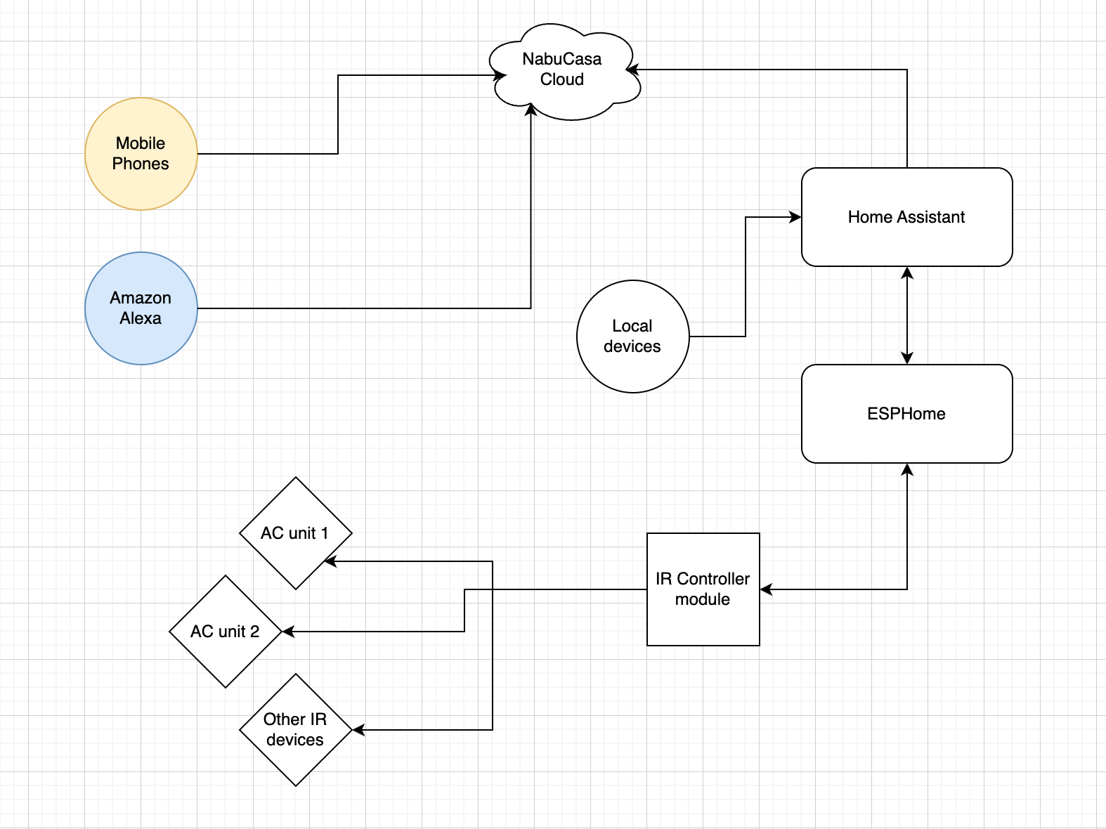
The infrastructure

Slide 4
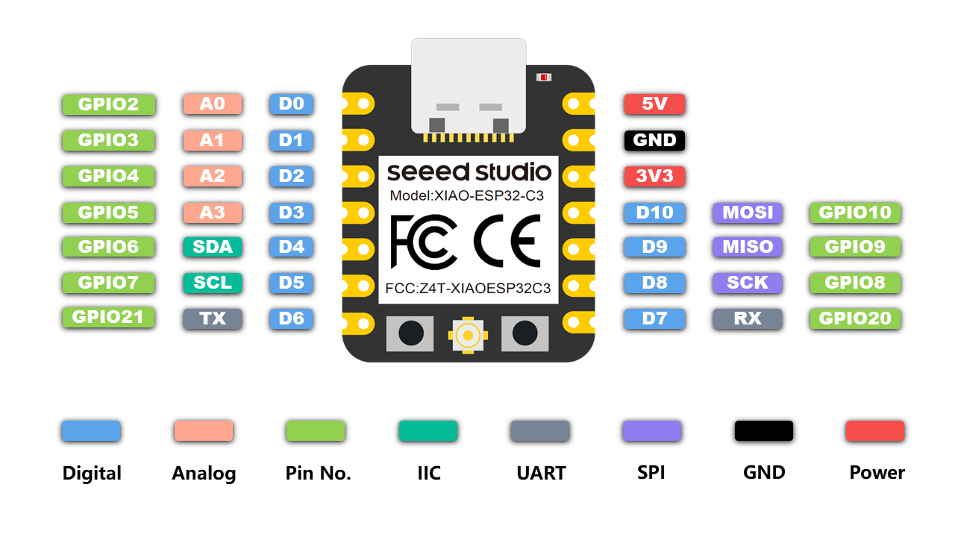
ESP32-C3

Slide 5
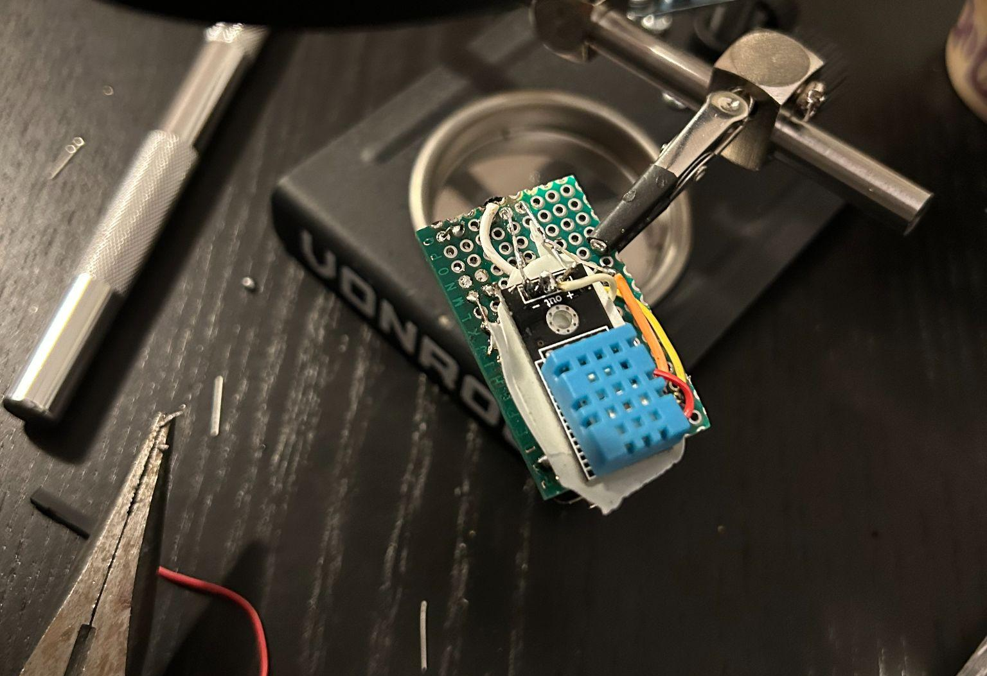
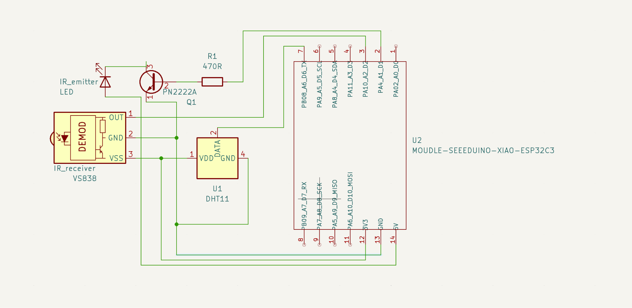
ESPHome IR Controller

Slide 6
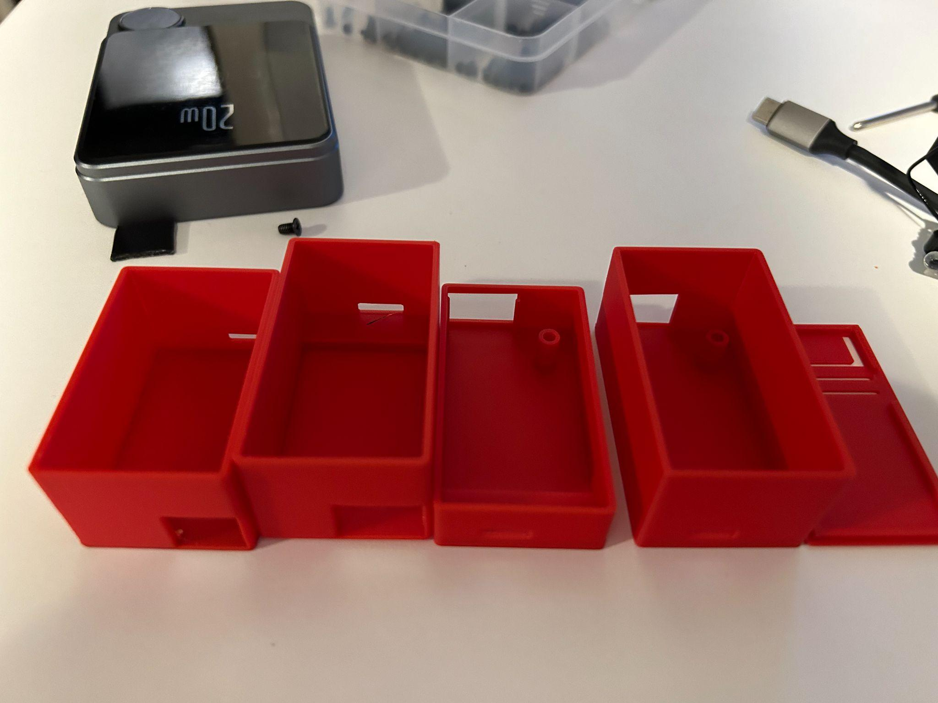
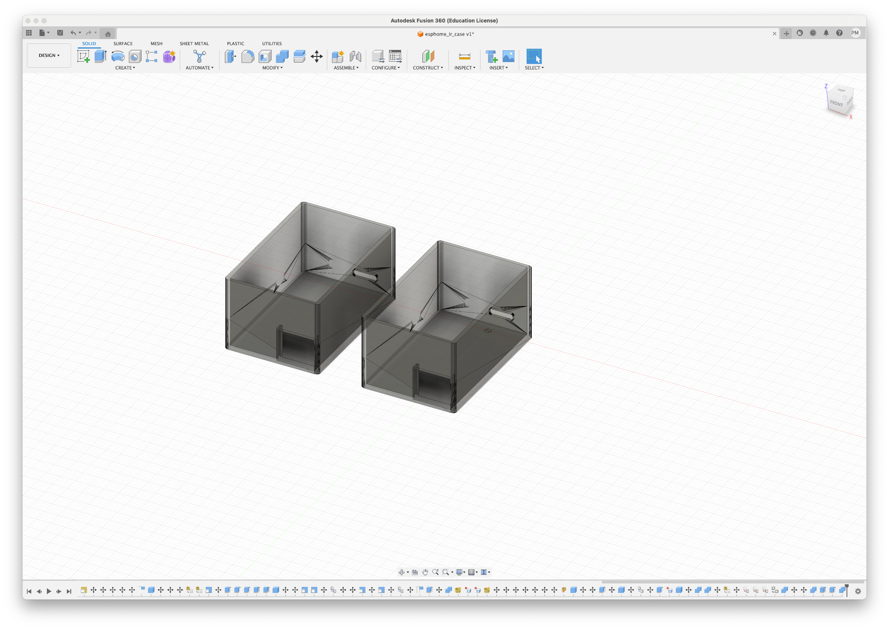
Enclosure

Slide 7
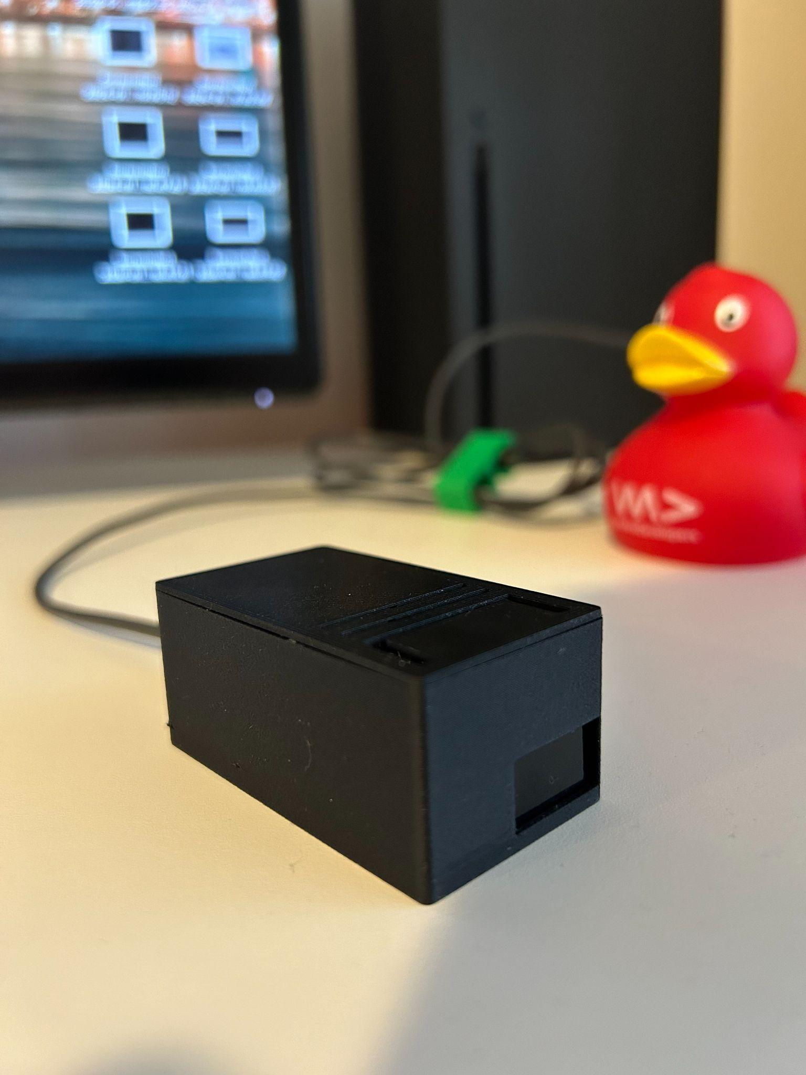
Enclosure

Slide 8
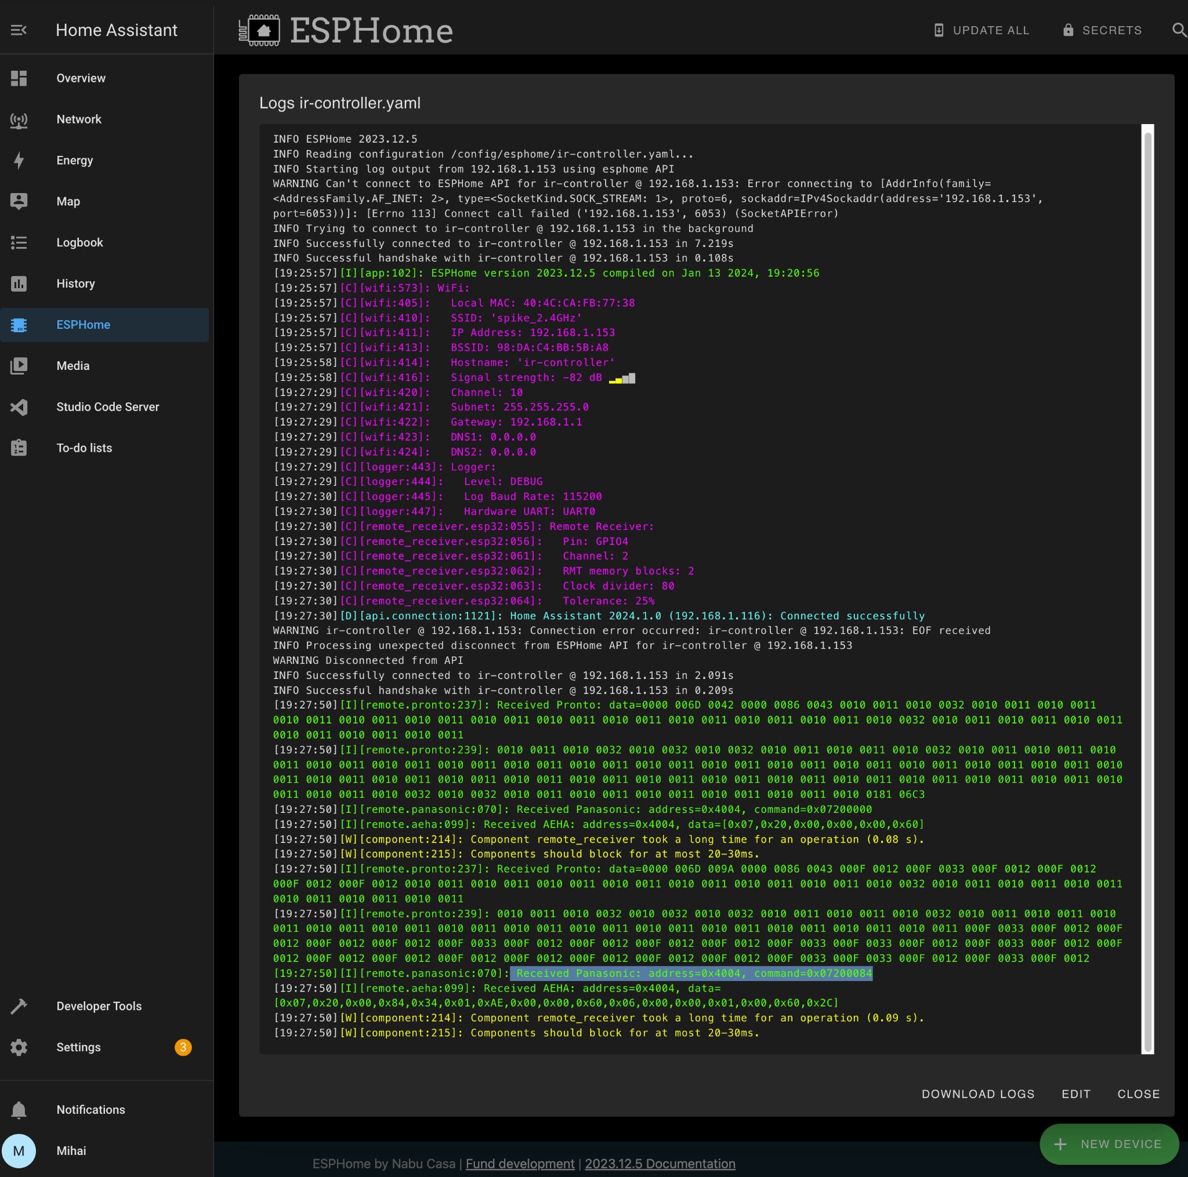
IR signals

Slide 9
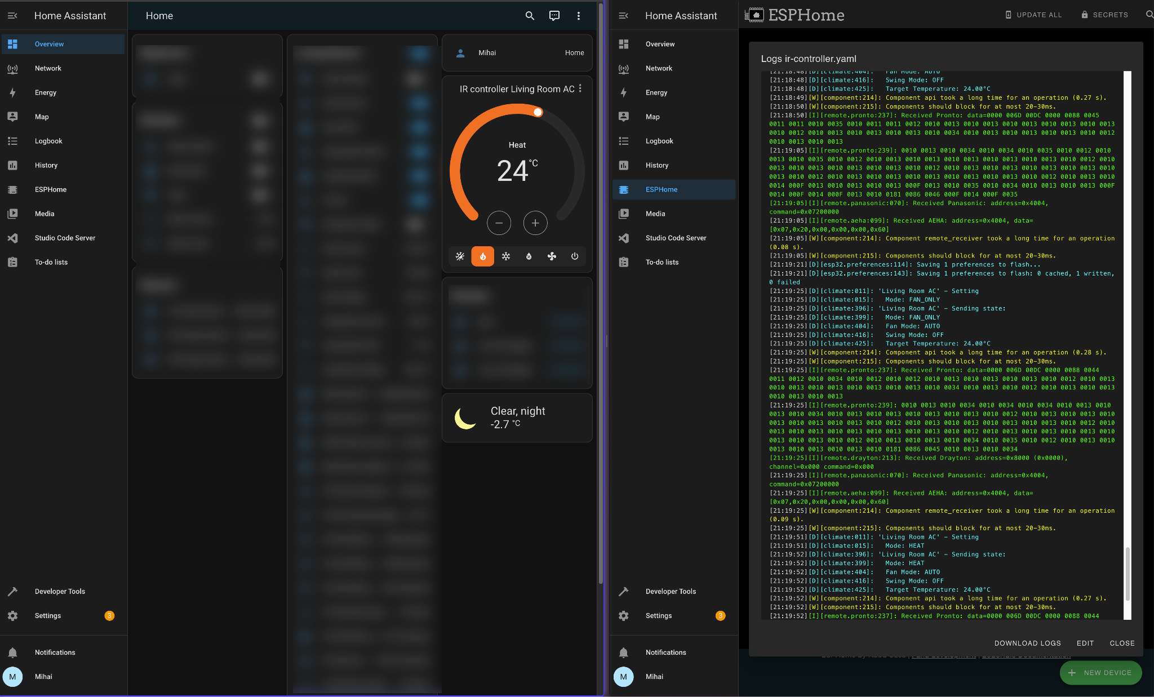
AC in Home Assistant

Slide 10
Thank you

